Slide 2
objectives
Compare the strengths and limitations of three segmentation techniques.
Explore how these segmentation techniques have practical applications.
result 1
result 2
Physics-301/Activity 1 - Color Segmentation.ipynb at main · reneprincipejr/Physics-301 (github.com)
https://drive.google.com/file/d/10yAmcNsyWs8dfkm6fHbPrnsFiF5YHBX9/view?usp=sharing
Notes:
In this activity, we applied blurring kernels of varying orientation and extent sizes, along with increasing degrees of NSR, synthetically, to a test image.
Given the blurred and noisy images, the restoration of the original image was performed by coding the using (1) packaged Weiner estimation via skimage.restoration and (1)estimation using Fourier transforms via numpy.fft in Python. The accuracy of reconstruction, given the blurring parameters, was quantified using the Structure Similarity Index (SSIM).
Lastly, we attempted to estimate the blurring parameters, such as motion direction and pixel extent, of a moving car to super-resolve its quality and decipher the text.

Slide 3
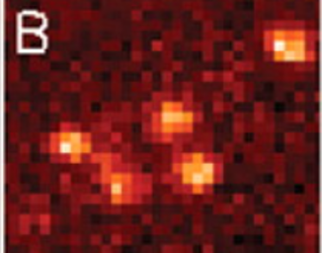
Background
Photoactivated Localization Microscopy (PALM) is an imaging technique that aims to improve understanding of biological dynamics and structures on a smallest level possible, that is beyond the diffraction limit. Fluorescent samples are photoactivated to facilitate its localization by fitting a gaussian. Repeating the localization process multiple times, the collection of the location information constitutes the super-resolving the image.
Notes:
https://www.science.org/doi/10.1126/science.112734

Slide 4
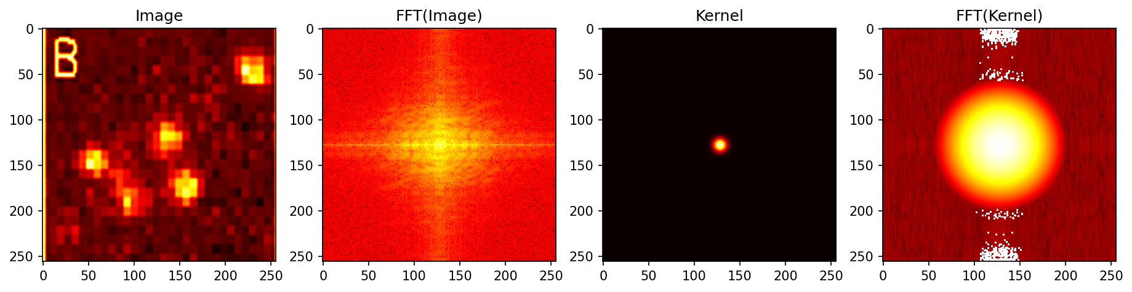
Overview
Typically, gaussian fitting algorithms does the job to localize the peaks, however, I wanted to the test if a good old Fast Fourier Transform (FFT) correlation technique can do the job. Essentially, it is a template matching technique that finds the similarities between a template kernel (i.e. a gaussian function) and the test image (activated cells), hence the correlation. Shown below are the test image, the gaussian kernel, and their corresponding FFTs.

Slide 5
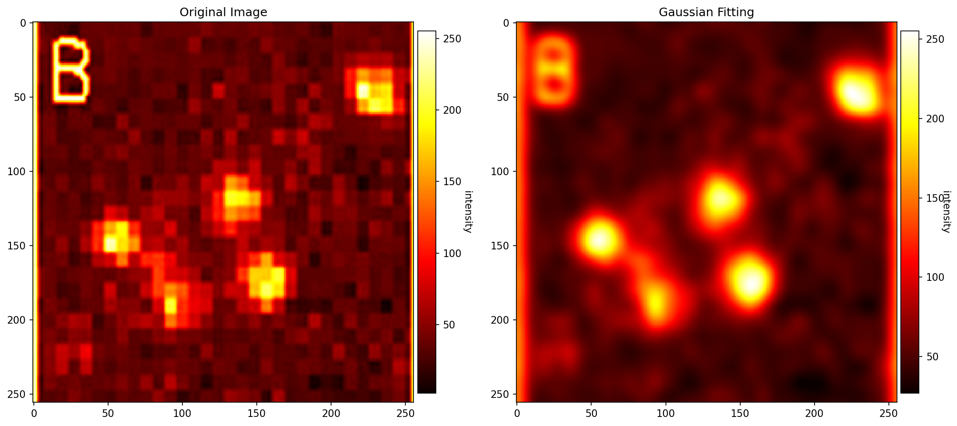
Overview
FFT correlation exploits the complex conjugates of the frequency domain between the two images, returning a correlation map that emphasizes the regions in the test image that closely reassembles the template kernel. From these smoothened image, localization can be done by setting a threshold or through centroid detections.

Slide 6
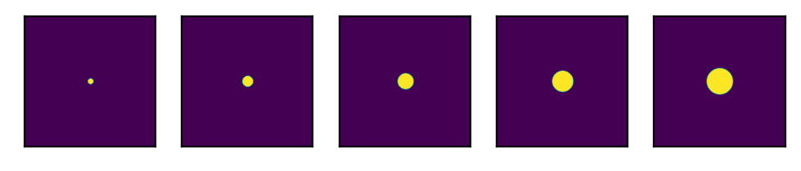
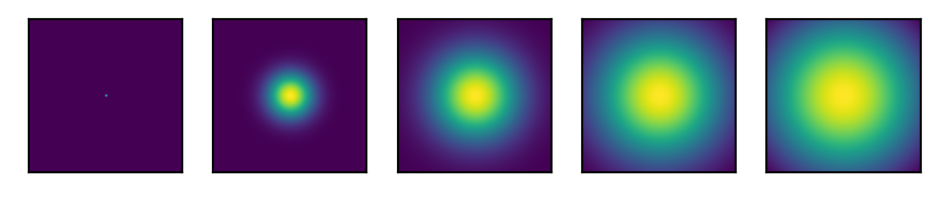
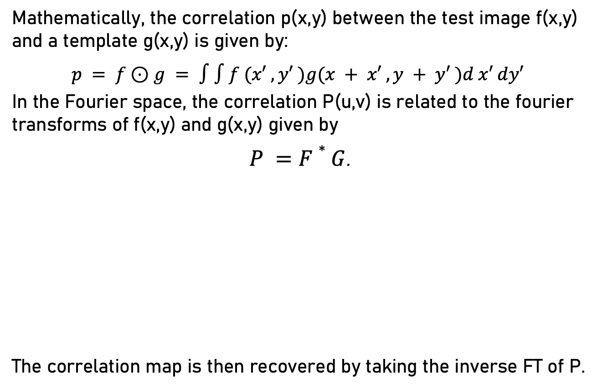
FFT Correlation
Mathematically, the correlation p(x,y) between the test image f(x,y) and a template g(x,y) is given by:
$p = f⊙g = ∫∫f (x′ , y′ )g(x + x′ , y + y′ )d x′ dy′$
In the Fourier space, the correlation P(u,v) is related to the fourier transforms of f(x,y) and g(x,y) given by
$P =F∗G$.
The correlation map is then recovered by taking the inverse FT of P.
Test Image: f(x,y)
Template Kernels: g(x,y)

Slide 7
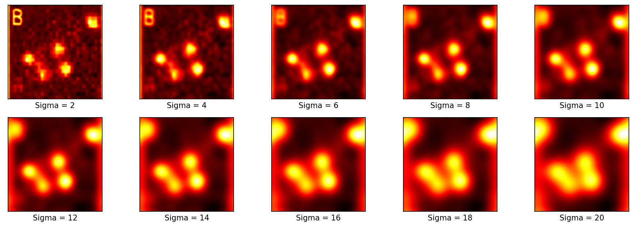
Results
Shown in the following pages are the correlation maps returned by using templates such as (1) gaussian kernels of increasing variances and (2) defocus kernels of increasing extent sizes. Unlike gaussian maximization which fits perfect gaussians to the test image’s localized peaks, FFT correlation technique preserve the cell’s irregularity while emphasizing the peaks and smoothening the entire image.
Gaussian Kernels: g(x,y)

Slide 8
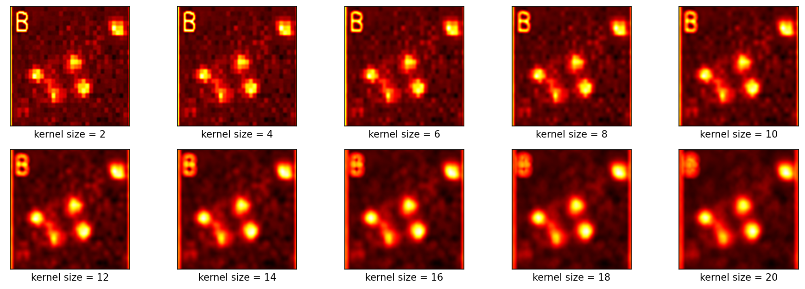
Results
FFT correlation map using gaussian template yielded sufficient results however, at large variances (way beyond the dimensions of the cells), a gaussian blur becomes prominent. Meanwhile, using a defocus kernel circumvents this problem as it emphasized the peaks and super-resolved the test image even at very large kernel sizes.
Defocus Kernels: g(x,y)

Slide 9
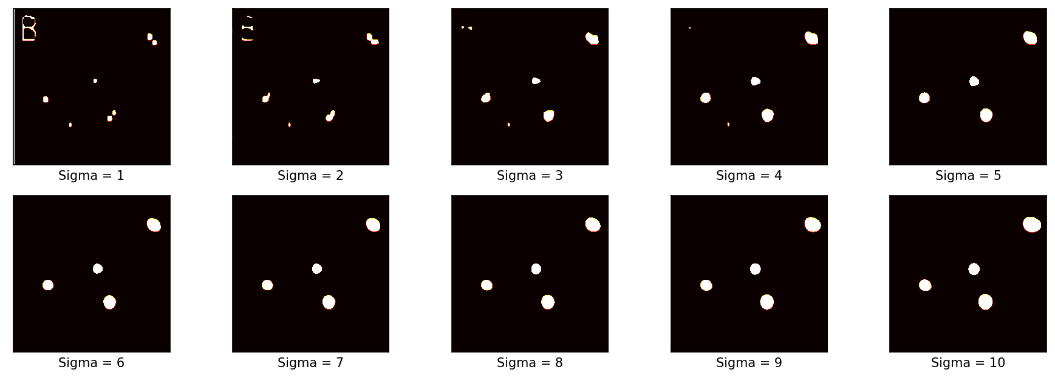
Gaussian Kernel

Slide 10
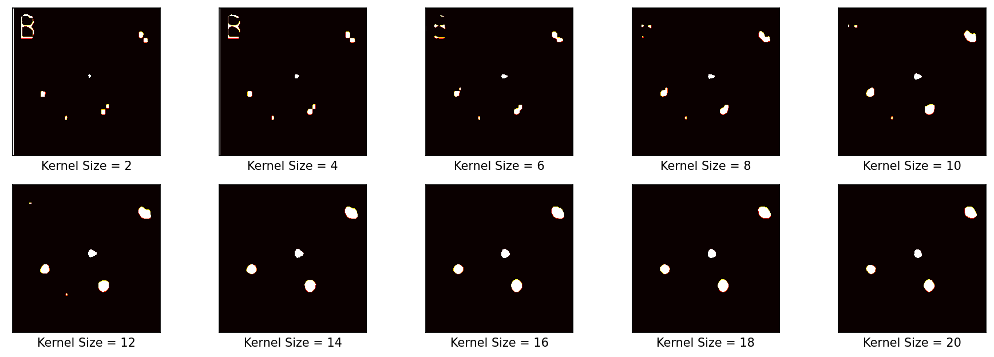
Defocus Kernel

Slide 11
Interestingly, thresholding the results for gaussian template eliminated the artifact correlation detection of the letter “B” on the upper left corner of the image right away on increasing variance. The thresholding results for the defocus kernel was able to eliminate the artifact at k = 14. Unfortunately, on both instances, the fifth faint blob on the lower left vanished in the correlation map as soon as the artifact letter was not mapped either. Hence, FFT correlation is effective on highly regular / relatively circular blobs.
Test Image: f(x,y)
Template Kernels: g(x,y)

Slide 12
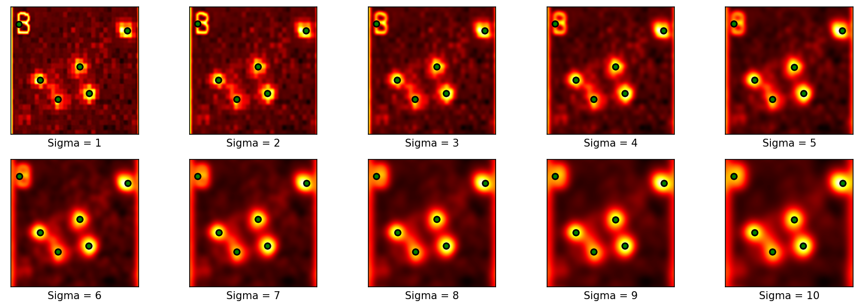
Centroid Detection
In the maximization technique as implemented by Reinier Ramos, individual gaussian fittings can sometimes merge two distinct blobs, while multivariate fittings can fit the gaussians well however, this requires a priori knowledge on how many peaks are there to be expected. With centroid detection applied on FFT correlations, the five peaks (excluding the “B” artifact which should not be present on experimental images) are well detected, the test image is retained but just super-resolved.

Slide 13
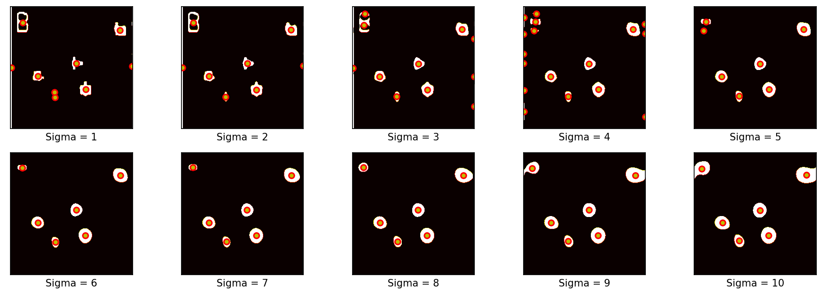
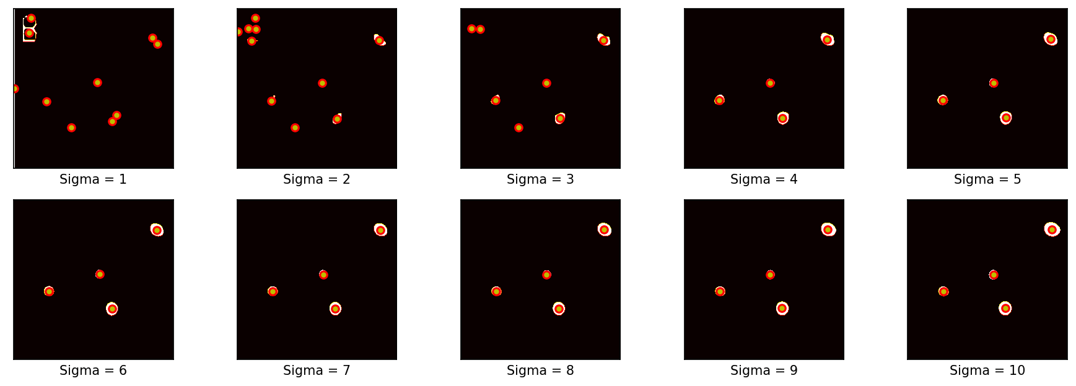
gray image threshold = 150
gray image threshold = 200

Slide 14
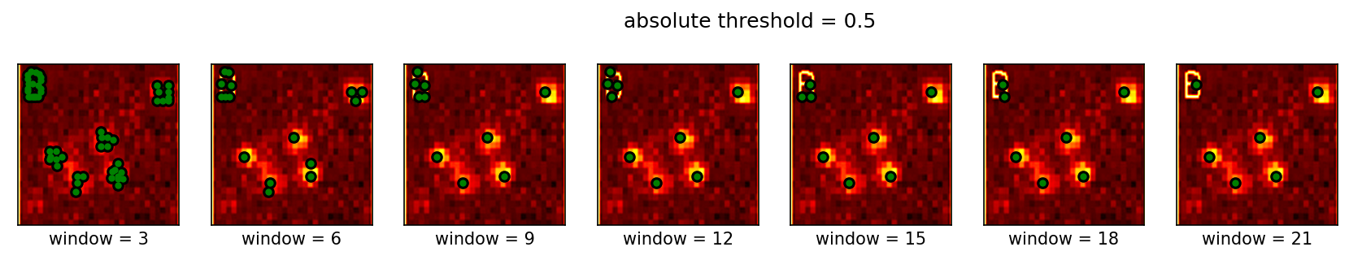
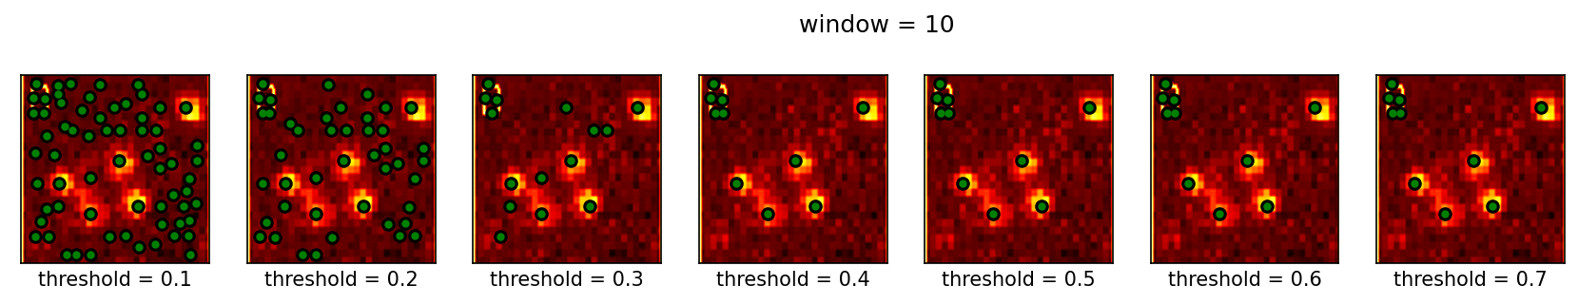
Peak local maximum detection on the raw test image right away struggles to localize the peaks and requires fine-tuning the window and threshold parameters as shown below.
Overall, it was demonstrated how the simple algorithm and concept FFT correlation does the job of super-resolving an image of photoactivated cells, simply by matching gaussian/defocus kernels to identify the positions and similarity.

Slide 15
reflection
This activity and the last made me appreciate the elegant power of Fourier transforms. Convolution and correlation concepts using FFT were used and in the end, I demonstrated how spatial super-resolution can be achieved by exploiting the frequency space alone. I have elaborated the parameter effects in the generated FFT correlation maps, applied thresholding and centroid detection techniques, with the end goal of localizing the peaks and super-resolving the image. I counterchecked these results to my classmate’s implementation of individual and multivariate gaussian expectation maximization.
With that said, I’d give myself a score of 105/100.
[1] M. Soriano, Physics 305 – PALM Superresolution, (2023).
[2] Betzig, E., Patterson, G. H., Sougrat, R., Lindwasser, O. W., Olenych, S., Bonifacino, J. S., ... & Hess, H. F. (2006). Imaging intracellular fluorescent proteins at nanometer resolution. science, 313(5793), 1642-1645.

